Slide 1
IRCTC
Team 7 | Persistent University

Slide 2
Introduction
IRCTC (Indian Railway Catering and Tourism Corporation) is a website to help us book train tickets within India.
The IRCTC was established on 27 September 1999, as a public sector undertaking completely owned by the Government of India through the Indian Railways.
Problem statement: To test IRCTC website for Logging in, Train search, Booking and canceling tickets.

Slide 3
Software Specification
Eclipse IDE
Java
Selenium
Maven
Postman

Slide 4
Manual Testing
The initial phase of our project was writing down the manual test cases for all the modules. To accomplish that we used excel format that is used by most of the testers.
Then classified written test cases into Automatable and Non-automatable.
Automable | Non-Automable
95 | 0
Positive | Negative
75 | 20
Pass | Fail | Skipped
79 | 11 | 5

Slide 5
Maven
Maven can add all the dependencies required for the project automatically by reading pom file.
To manage all the required dependencies of our project we created a maven project and added all the required dependencies of jar files in pom.xml file.

Slide 6
Project Object Model
Project Object Model is a design pattern in selenium that creates an object repository for storing all the webelements.
We implemented Project Object Model as our project had many modules resulting in a greater number of Web Elements.

Slide 7
TestNG
TestNG is a testing framework that makes selenium tests easier to understand and helps generating reports that are easy to understand.
We have combined all the test cases within single scenario in single file which becomes easy to understand and execute.

Slide 8
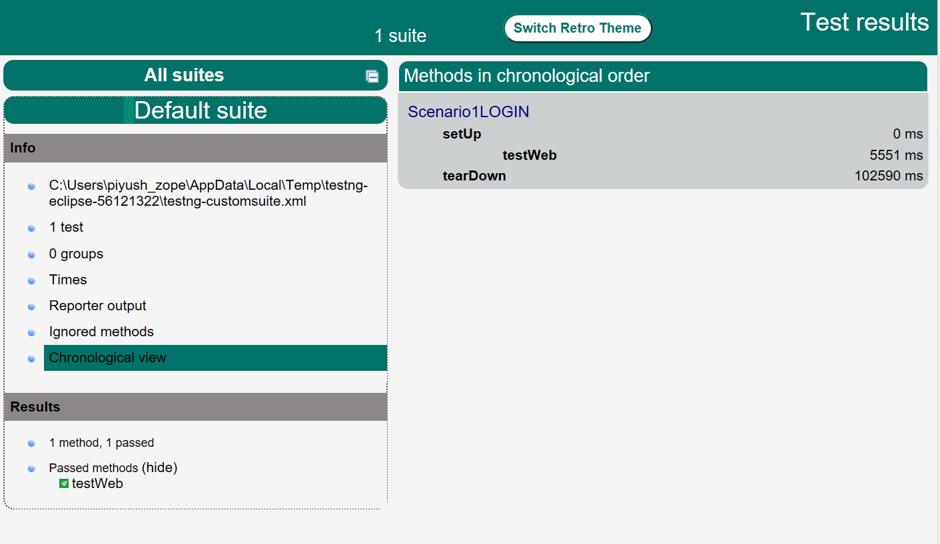
TestNG
Fig. Report Generated Using TestNG

Slide 9
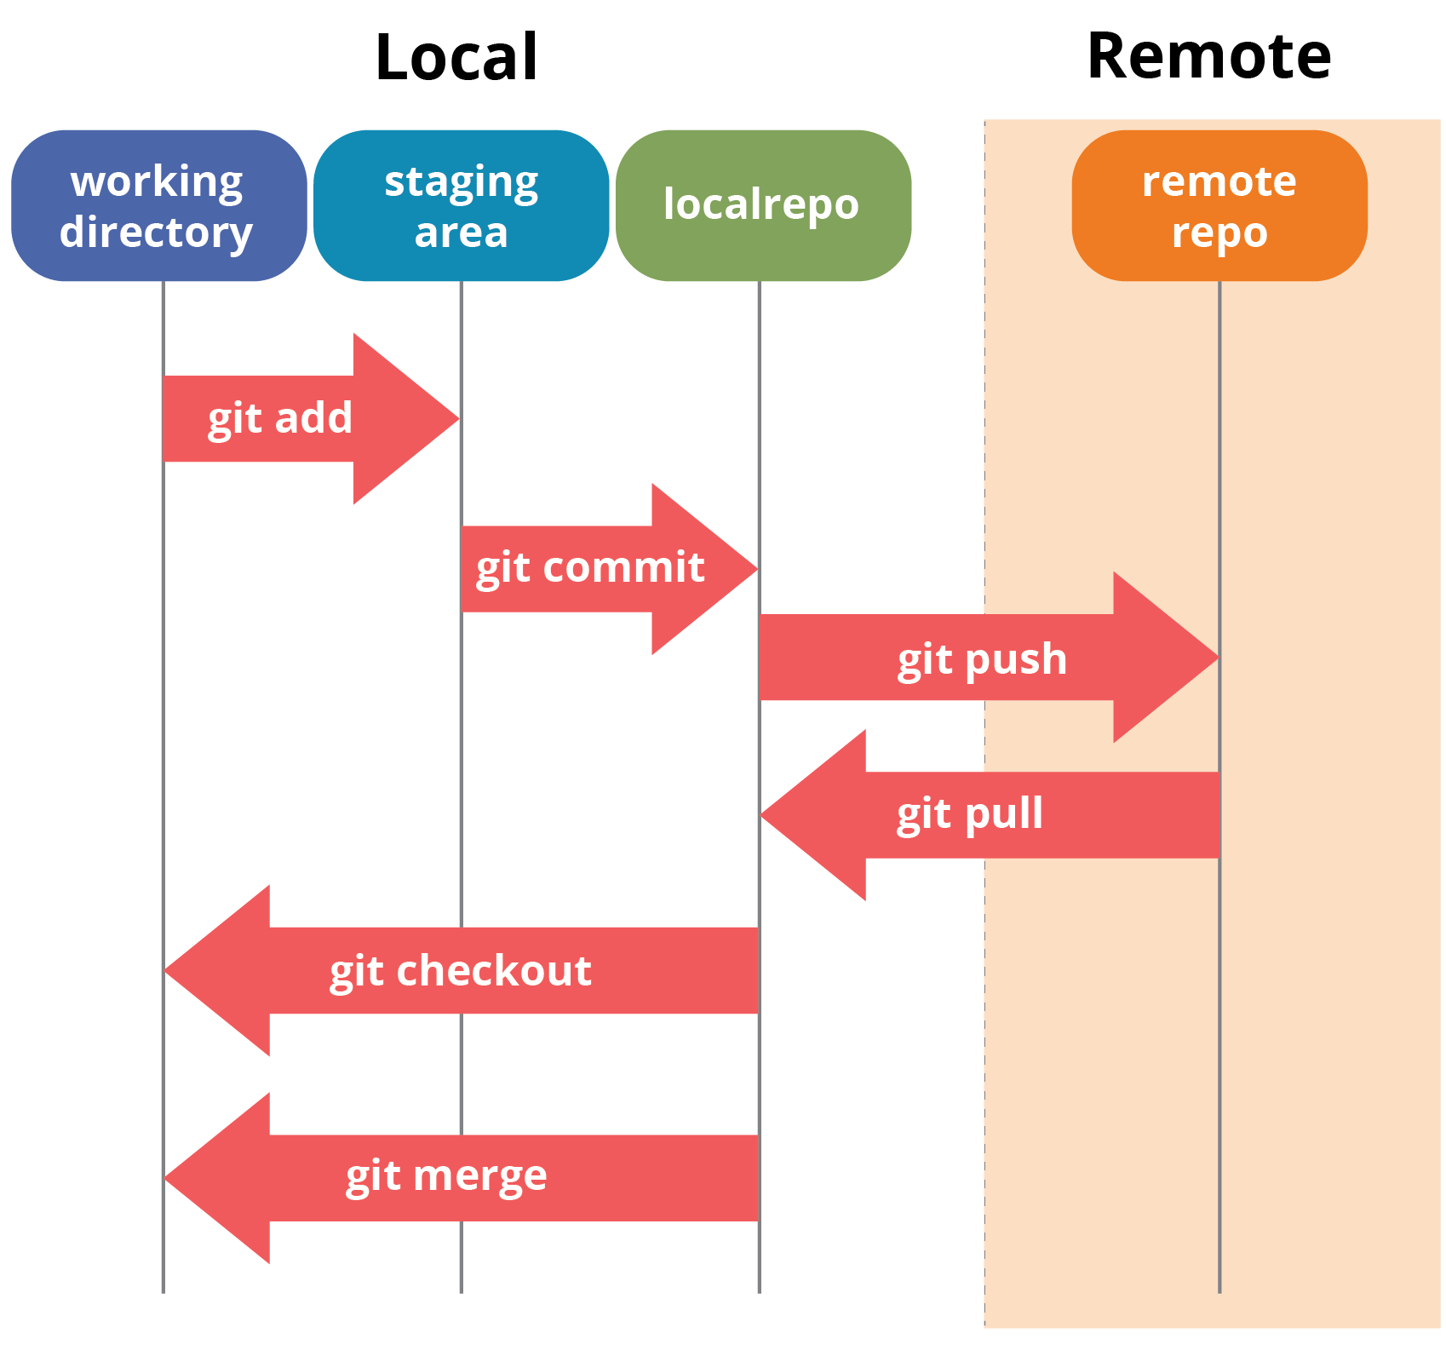
Git
Git is a distributed version control system.
It is free and open source.
It is used to keep track of all the changes that we make in the project files.

Slide 10
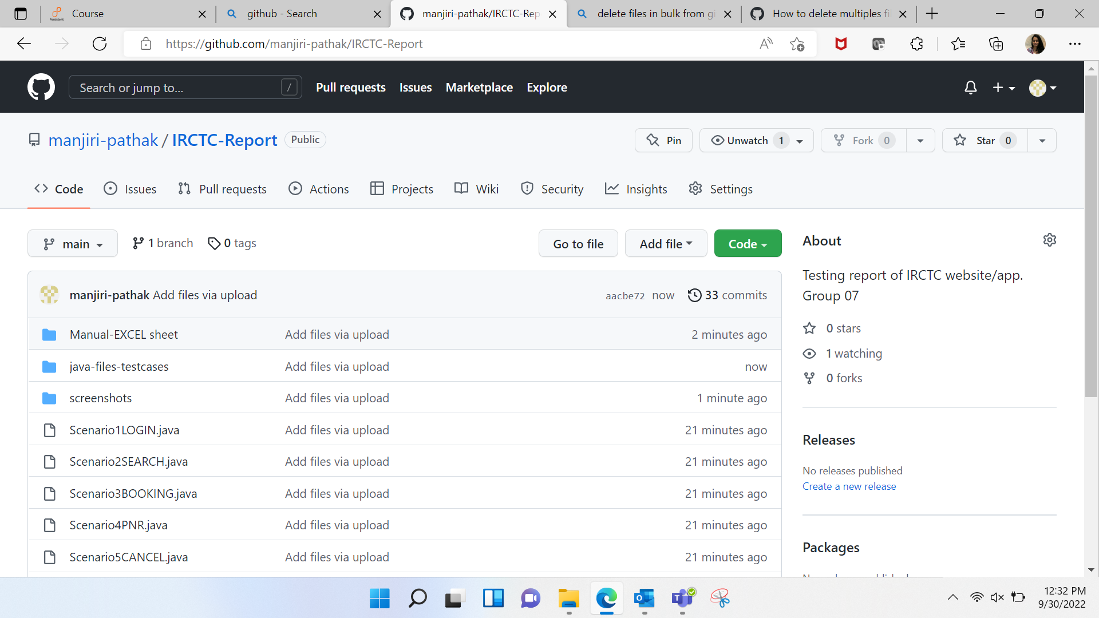
Fig. Commit of Project Performed on Git

Slide 11
Work Distribution - Selenium
Shubham: More options(forgot account details, e-wheel chair) Manual test cases and scenario for login functionality.
Shamika: Manual test cases and scenario for Bus Module.
Amaan: Manual test cases and Navigation Module(Alert,Contact us).
Manjiri: Selenium automation scripts for Hotel Page.
Piyush: Selenium automation scripts for Train Panel,Home page and Promotions.
Sanket: Selenium automation scripts for Airline Module..
Pratham: Maven environment setup and Holidays,Loyalty Module.
Ujjawal: Api, Postman setup and more module(Cancellation,Boarding point change).
Shubhasmita: Selenium automation scripts for Meals module - E-Catering, Pantry Car and Cooked food menu.

Slide 12
API TESTING
API testing is a type of software testing where application programming interfaces (APIs) are tested to determine if they meet expectations for functionality, reliability, performance, and security.

Slide 13
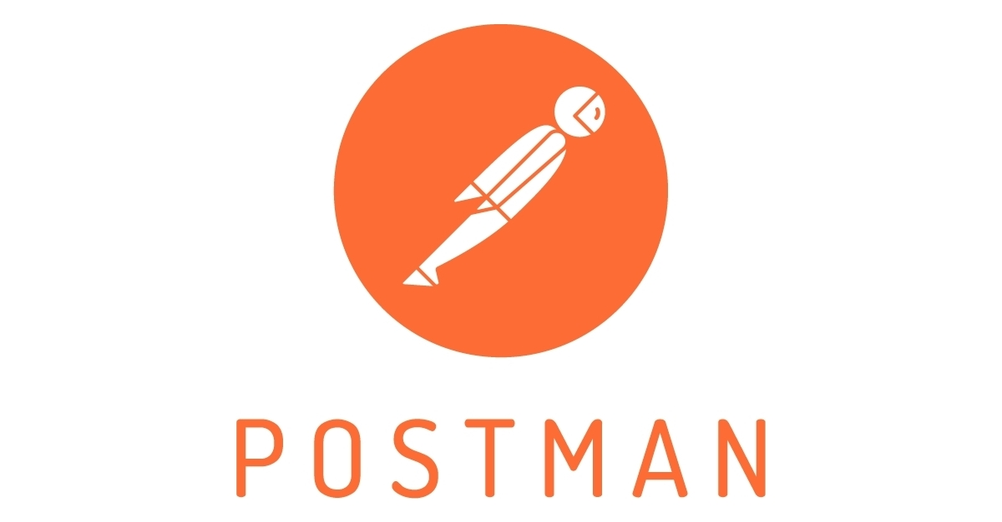
POSTMAN
Postman is a collaboration platform for API development
Using the Postman tool, we can send HTTP/s requests to a service, as well as get their responses.
We are using Postman to be more efficient while working with APIs.

Slide 14
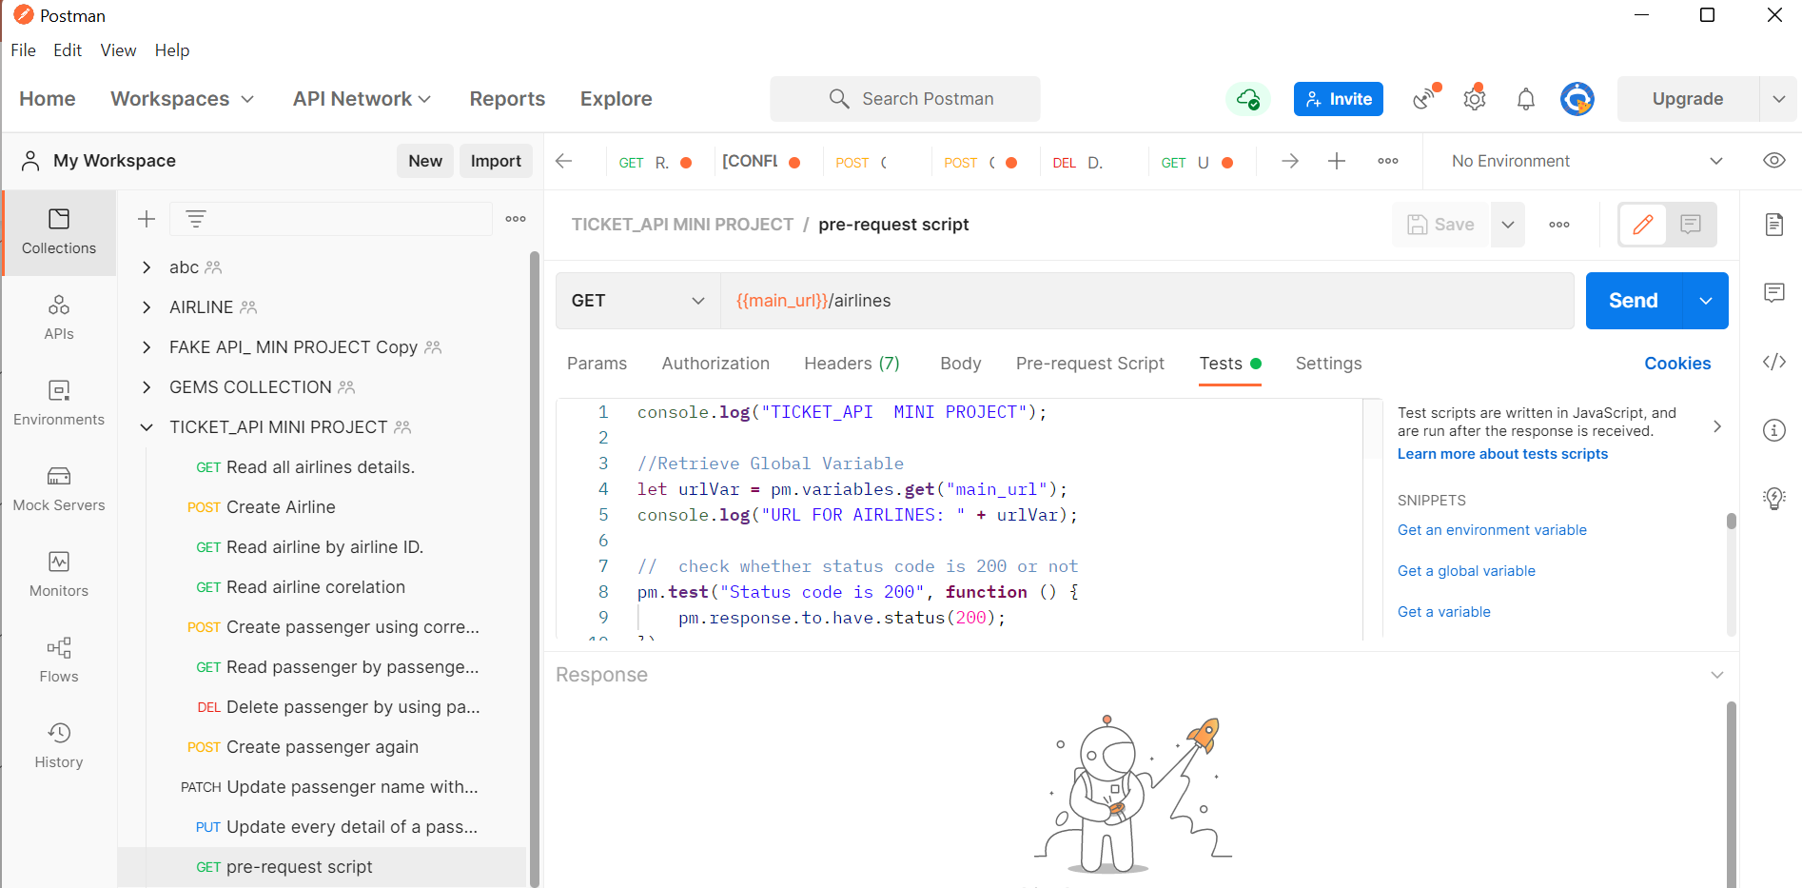
Fig. Postman Code Execution

Slide 15
Overview
Enabled API support using local Database
Collaboration with team using Postman Workspace
Postman Features used -
1. HTTP Methods (GET/POST/PUT/DELETE/PATCH )
2. Global variables
4. Collection
5. Correlation
6. Tests Script
7. Schema Validation
8. Pre-request Script

Slide 16
Json Schema Validation
JSON Schema is a contract for JSON document that defines the expected data types and format of each field in the response.
We use JSON Schema to construct a model of API response and it makes easier to validate that API is returning the valid data.

Slide 17
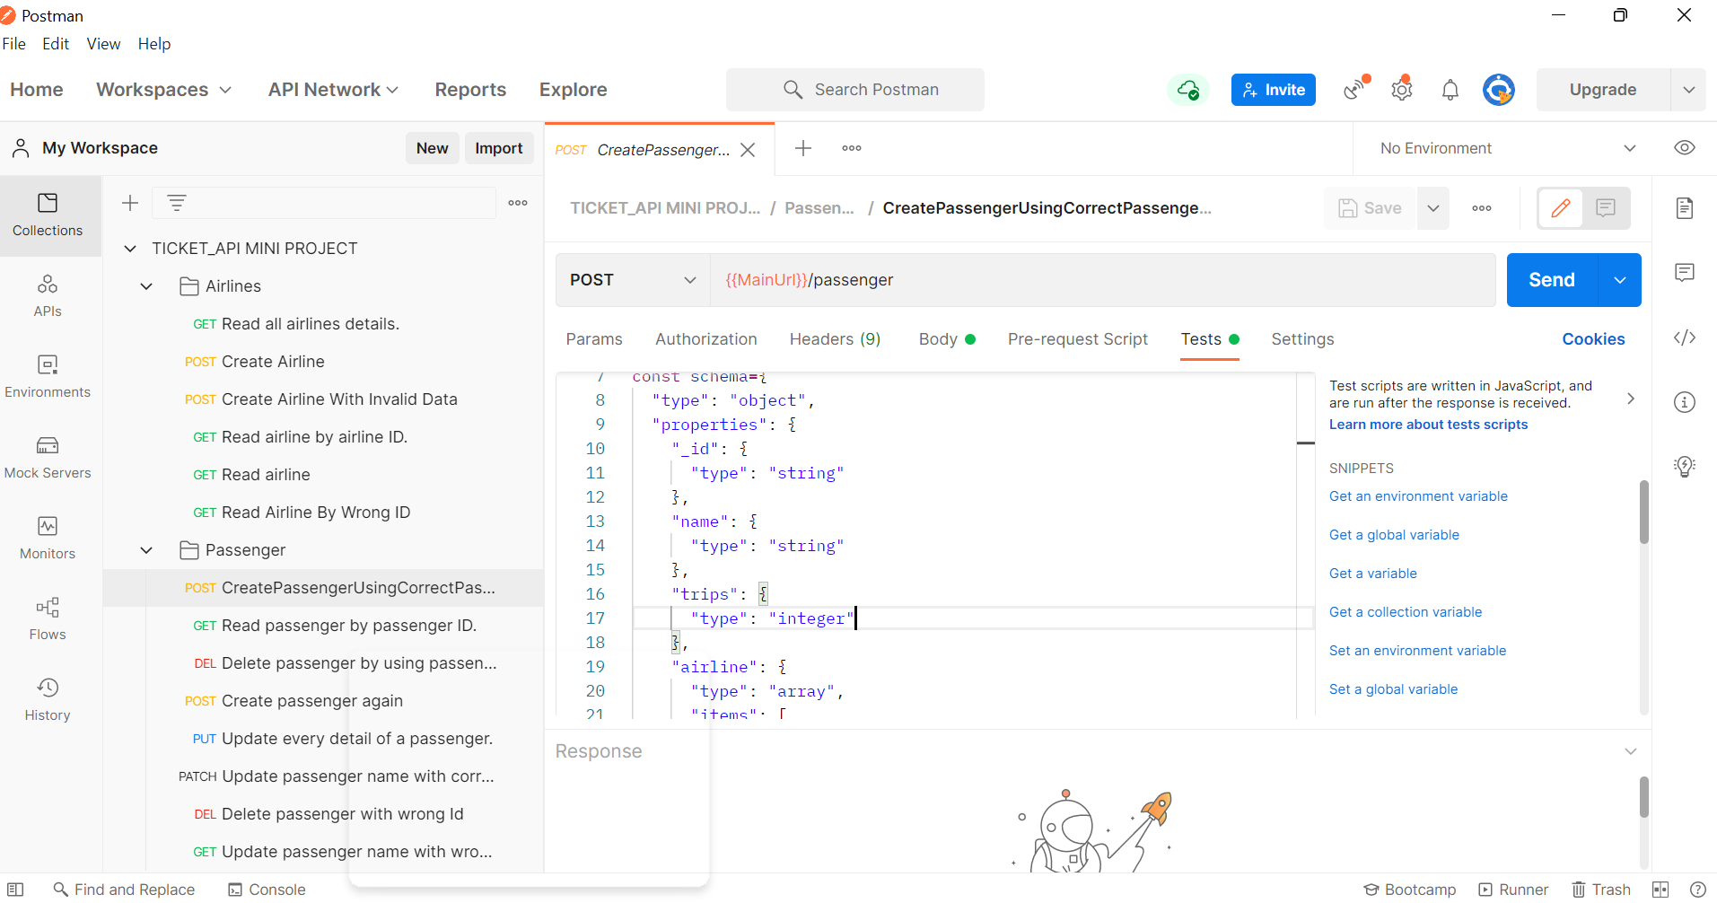
Fig. JSON Schema Validation

Slide 18
Negative Scenario
Negative testing is the process of applying as much creativity as possible and validating the application against invalid data.
This ensures proactively exploring the edge cases to increase the resilience of your APIs.
Negative testing is a type of testing in which a tester intentionally enters invalid data in the system to check the robustness of the application.

Slide 19
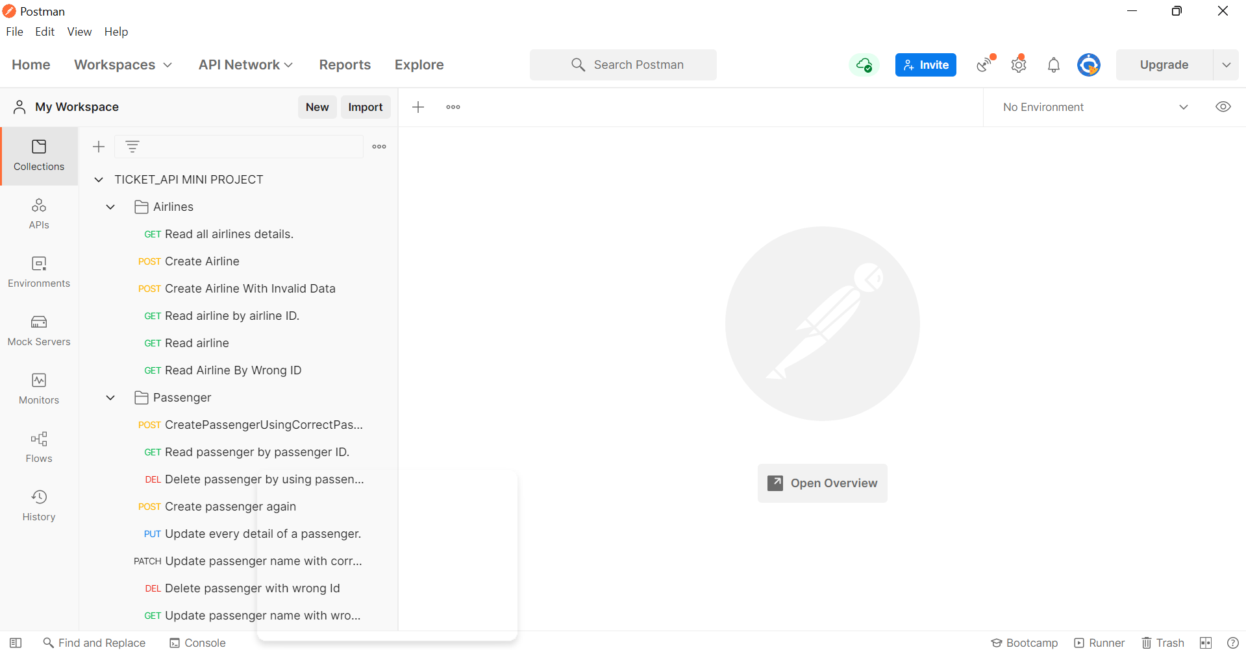
Fig. Negative Scenario List

Slide 20
Issues and respective learnings
Sr. no. | Issues Facing | Remedy | Issue Occured Date | Issue Resolved Date | Comments | Status
1 | Proper Setup Installation of Eclipse IDE | Communicating with EIS_Service Desk team to resolve the issue | 7/10/2021 | 8/10/2021 | Getting system generated errors while installing TestNG suite on eclipse oxygen | Resolved
2 | Dynamic id of IRCTC Website | Communicated with trainer to resolve the issue. | 7/9/2022 | 12/9/2022 | Used full x paths to access website elements | Resolved
3 | Captcha validation while accessing IRCTC website | Communicated with trainer to resolve the issue. | 16/9/2022 | 17/9/2022 | Introduces wait in code and entered captcha manually | Resolved

Slide 21
Thank you!
Persistent Interactive | Persistent University

